Slide 1

Midterm project
COVID-19 Data Analytics:
Examining Patterns of Spread, Severity, and Health System Response"
Group members: Prashanth Raju Anais Lacreuse, Drasti Sanghani, Mahankali Sai Kumar
Scalable Databases FALL 2024 72913

Slide 2
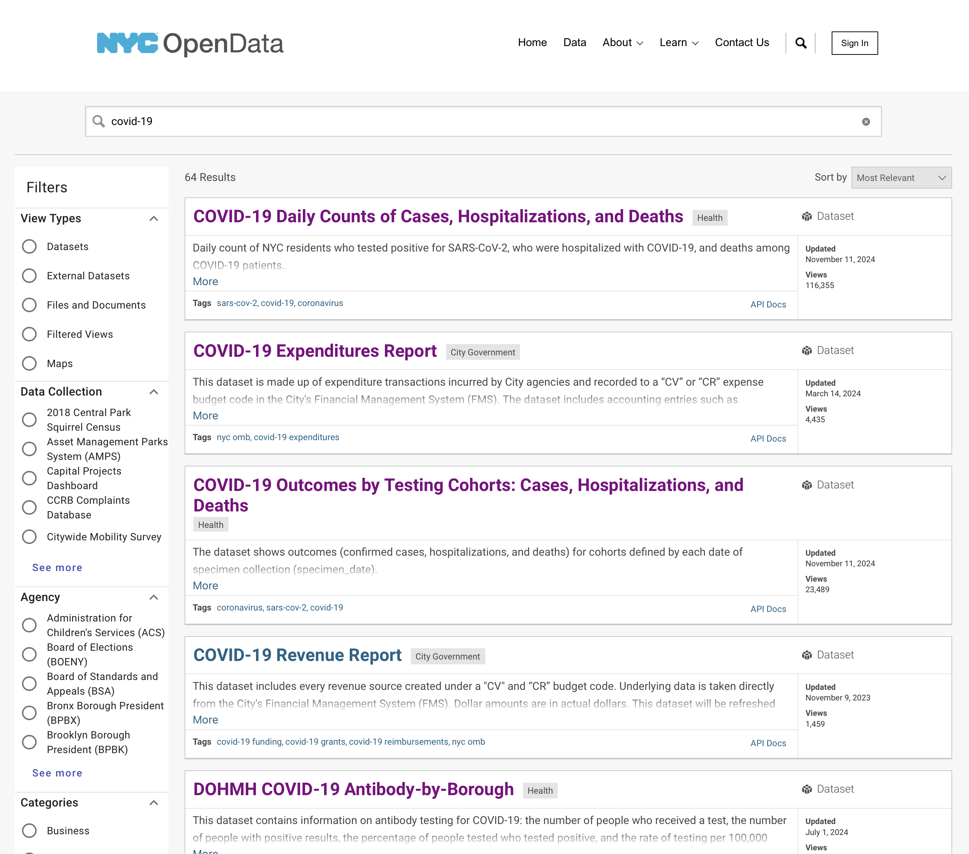
Datasets:
Selecting these three datasets provides a well-rounded view of COVID-19’s impact, enabling a detailed analysis of the pandemic from multiple angles.
Testing data offers insight into the reach and prevalence of infection, hospitalization data reveals the pandemic's severity and healthcare implications, and case counts and death rates allow us to quantify the toll on human life.
By integrating these datasets, we gain a comprehensive understanding that can inform current public health decisions and future pandemic preparedness.
Scalable Databases FALL 2024 72913

Slide 3
Explaination Of The Datasets:
COVID-19 Testing Data is instrumental in understanding the prevalence of infections within a community. This dataset captures testing trends, including the total number of tests conducted and the rate of positive results over time. By examining testing trends, we can identify potential surges in cases, detect the spread of infections within communities, and evaluate the success of testing strategies in curbing transmission. High positive test rates, for example, might indicate inadequate testing coverage or rapid viral spread, underscoring areas where further public health interventions may be necessary.
Hospitalization and Influenza-Like Illness (ILI) Data offer insights into the severity of the pandemic's impact on healthcare systems. This dataset typically includes numbers on hospital admissions and cases of severe respiratory symptoms similar to COVID-19. Monitoring hospitalization rates reveals the burden on hospitals and helps assess the healthcare system’s capacity to manage surges in cases. High hospitalization rates can indicate more severe illness in the population and serve as a warning sign of potential healthcare strain. By tracking hospitalizations over time, public health officials can also gauge the effectiveness of interventions, such as social distancing or vaccination campaigns, in preventing severe illness.
Case Counts and Death Rates provide the core metrics of the pandemic’s impact. Tracking the total number of COVID-19 cases and deaths allows public health professionals to monitor the overall trajectory of the pandemic, evaluate mortality trends, and assess factors that increase the risk of severe outcomes. By analyzing death rates in relation to total cases, it’s possible to estimate the pandemic's fatality rate and understand which groups are most at risk. These data points also play a crucial role in evaluating the effectiveness of policy measures and medical advancements, such as treatments and vaccines, in reducing mortality.
Scalable Databases FALL 2024 72913

Slide 4

Datasets Challenges:
Challenge 1: Handling Missing Values
Solution: Missing values can disrupt the analysis and model training. To handle this, you can:
Impute values using the mean or median for numerical data.
Forward fill or backward fill for time-series data, filling gaps with the previous or next available data.
Remove rows with excessive missing values if they’re not critical.
Challenge 2: Outliers Affecting Data Quality
Solution: Outliers can distort trends and predictions. To handle outliers, you can:
Identify outliers using Z-scores or IQR.
Cap values or Winsorize extreme values to reduce their impact.
Log-transform data to make the distribution more normal.
Challenge 3: Data Inconsistencies Across Time Periods
Solution: When dealing with time-series data, different formats or irregular intervals can cause inconsistencies. To address this:
Standardize date formats and ensure consistency across the dataset.
Reindex the data to fill missing time periods with appropriate values, like forward filling or interpolation.

Slide 5
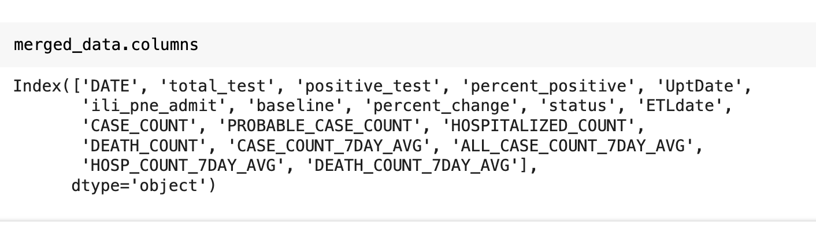
After combining 3 Datasets:
Scalable Databases FALL 2024 72913

Slide 6
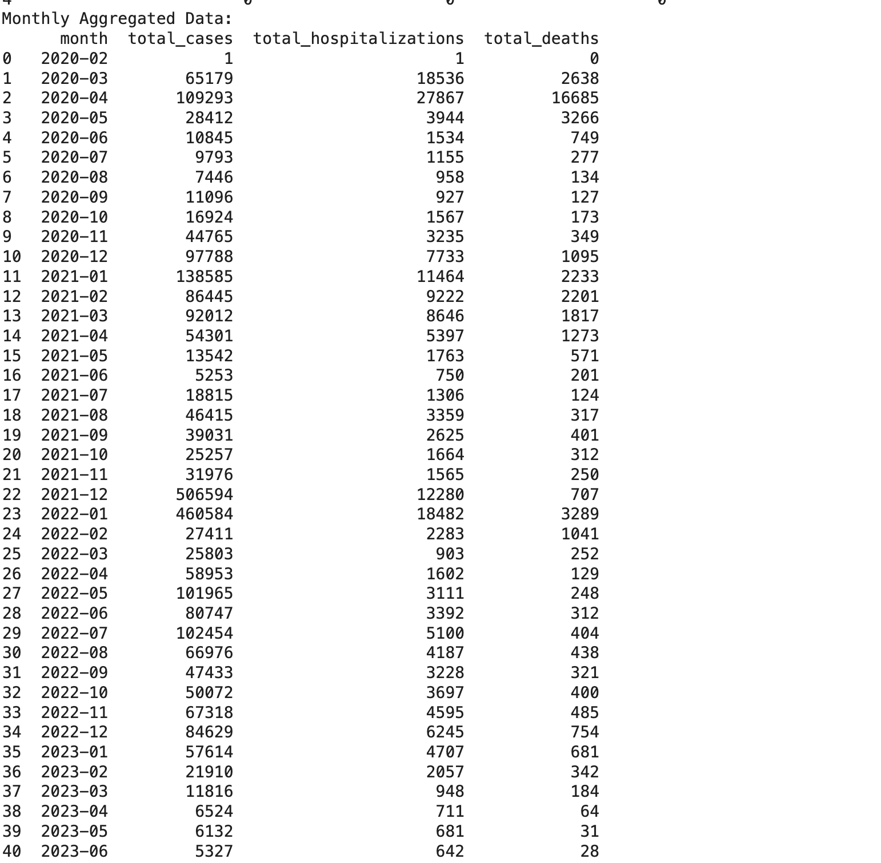
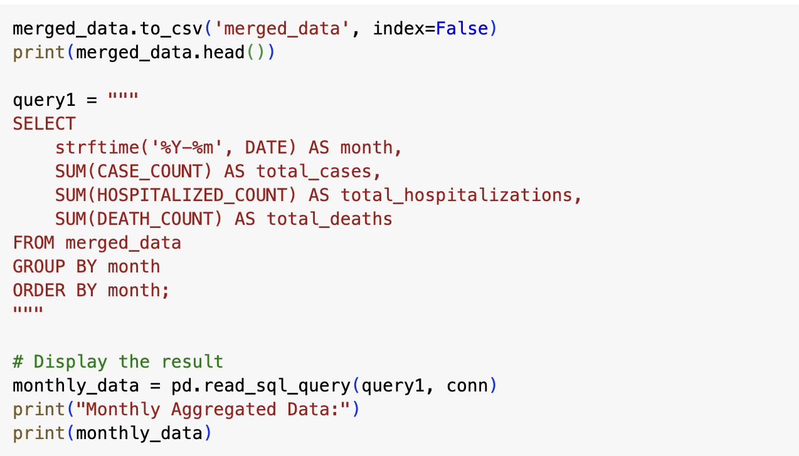
Query 1 : Aggregate monthly data for cases, hospitalizations, and deaths
SQL QUERIES
Scalable Databases FALL 2024 72913

Slide 7
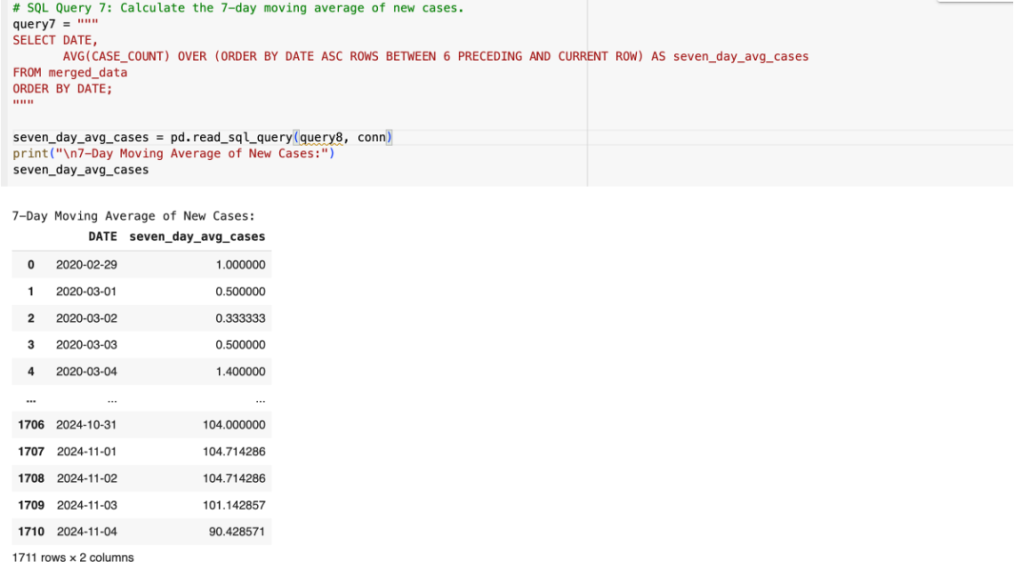
Query 2 : Calculate the 7-day moving average of new cases.
Scalable Databases FALL 2024 72913

Slide 8
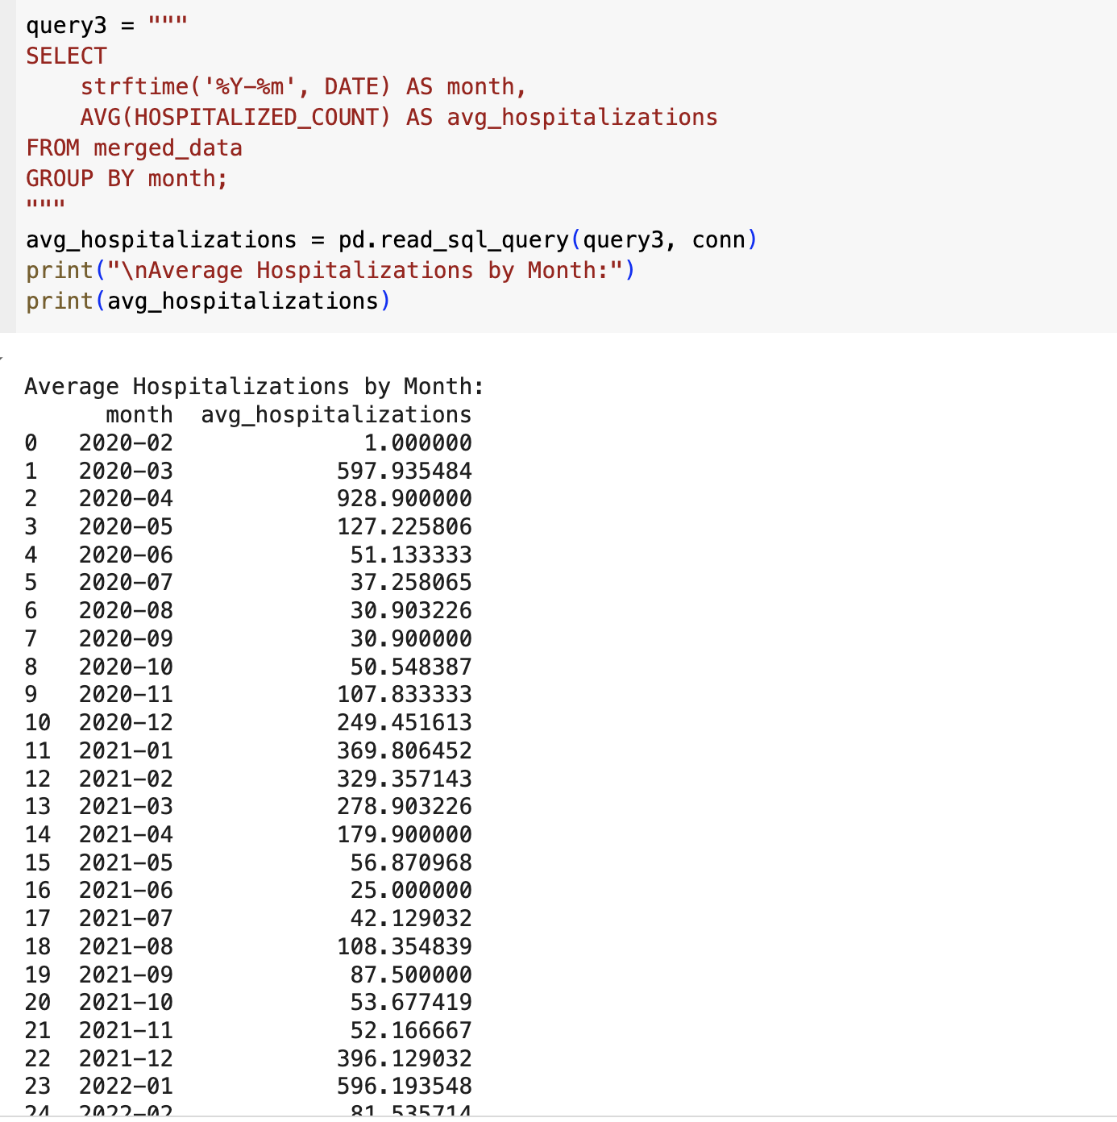
Query 3 : Average hospitalization rate per month
Scalable Databases FALL 2024 72913

Slide 9
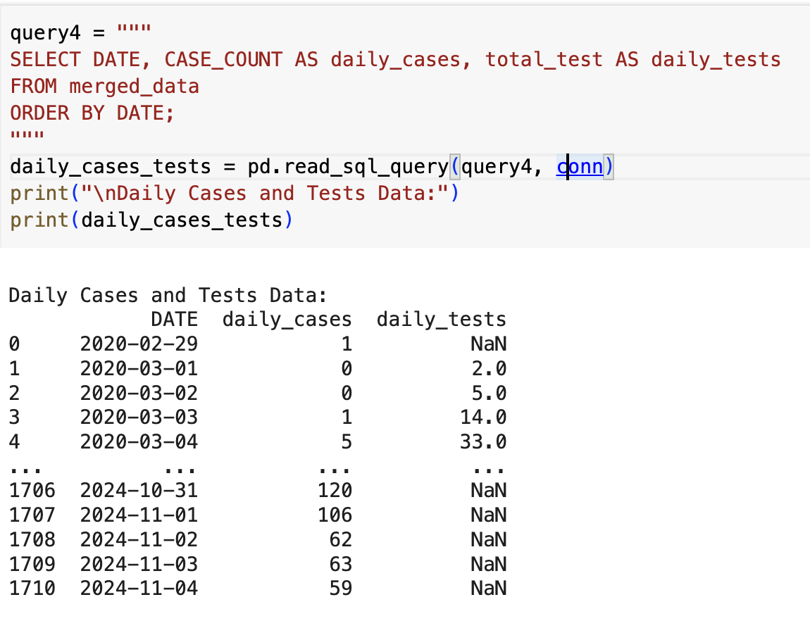
Query 4 : Total cases and tests per day
Scalable Databases FALL 2024 72913

Slide 10
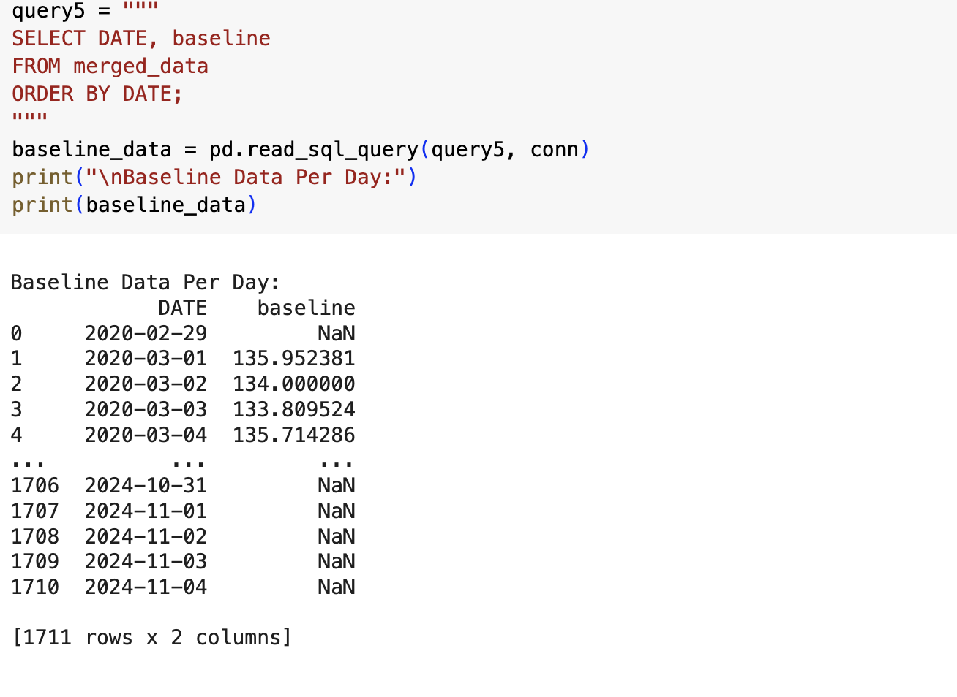
Query 5: Baseline Data Per Day
Scalable Databases FALL 2024 72913

Slide 11
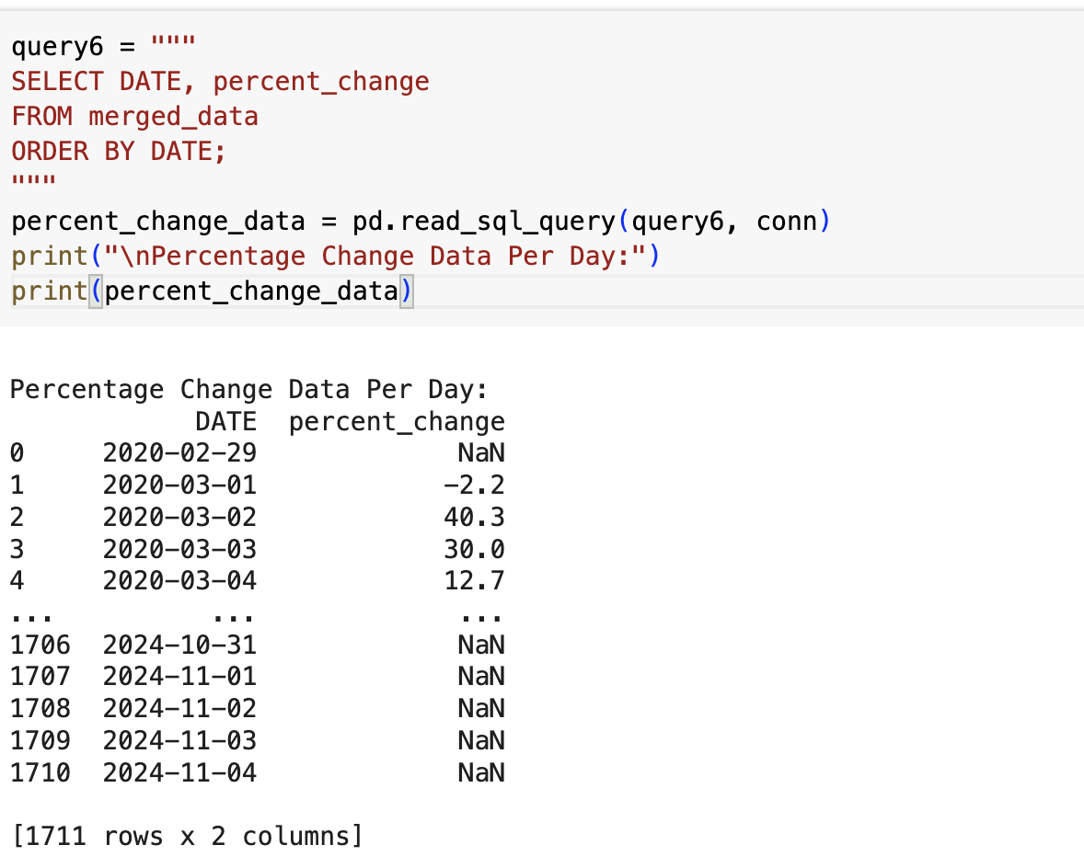
Query 6 : Percentage Change Data Per Day
Scalable Databases FALL 2024 72913

Slide 12
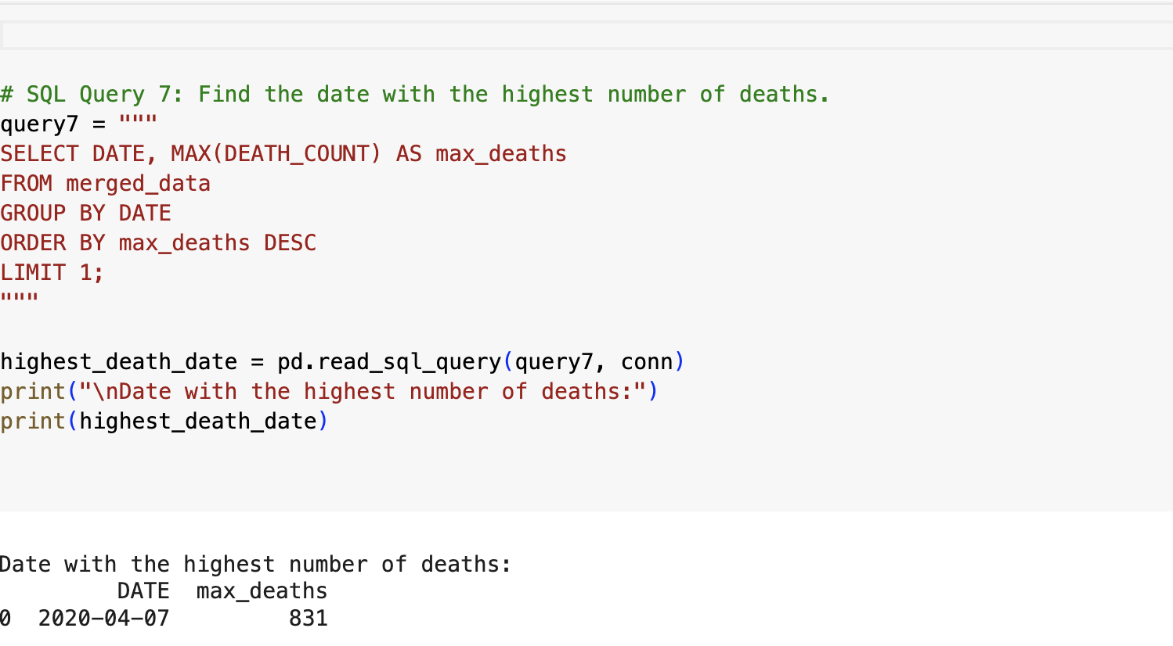
Query 7 : Find the date with the highest number of deaths.
Scalable Databases FALL 2024 72913

Slide 13

Data Visualization
Scalable Databases FALL 2024 72913

Slide 14
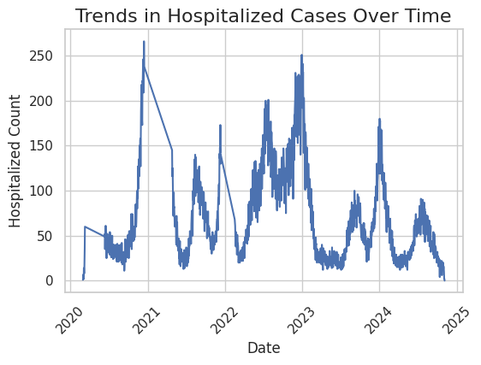
Hospitalized Count Over Time
The graph shows the trend in COVID-19 hospitalizations over time, beginning near zero in early 2020 and experiencing several significant peaks and declines.
Major spikes occur in early 2021, mid-2022, and early to mid-2023, with hospitalization counts reaching close to or above 200, likely corresponding to pandemic waves.
Between these peaks, the graph shows sharp declines, indicating periods when COVID-19 transmission or hospitalization rates decreased, possibly due to effective interventions or seasonal variations in case severity.
Scalable Databases FALL 2024 72913

Slide 15
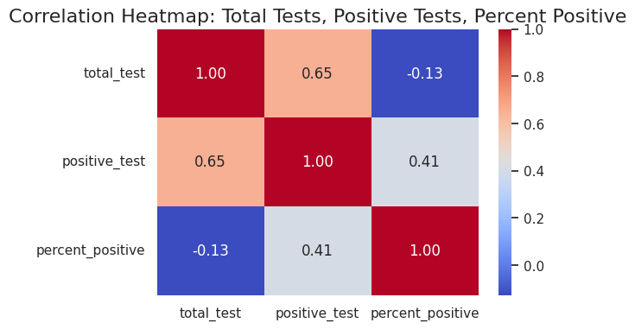
Correlation Heatmap:
total_test and positive_test (0.65): There is a moderate positive correlation between the total number of tests and the number of positive tests. This suggests that as the number of tests increases, the number of positive results tends to increase, which is expected if the overall positivity rate remains stable.
total_test and percent_positive (-0.13): There is a weak negative correlation between the total tests and the percent positive. This suggests that as the total number of tests increases, the percentage of positive cases slightly decreases, which could indicate that increased testing reaches more people who are less likely to be positive.
positive_test and percent_positive (0.41): There is a moderate positive correlation between the number of positive tests and the percent positive. This indicates that as the number of positive cases increases, the percentage of positive tests tends to increase as well.
Scalable Databases FALL 2024 72913

Slide 16
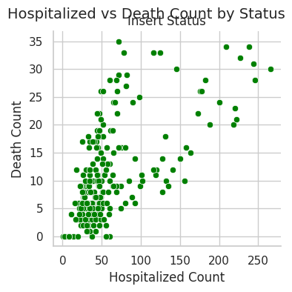
Comparison of Insert Status:
In first it got the high and later it decreases both admitted to hospitals and deaths
Scalable Databases FALL 2024 72913

Slide 17
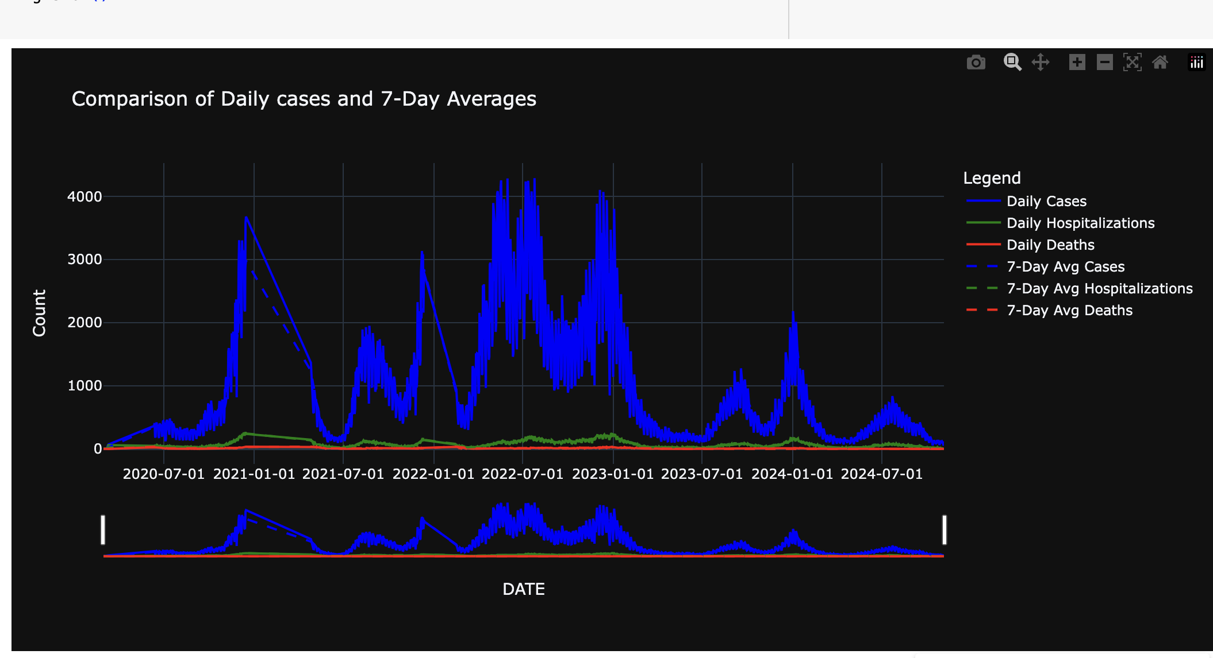
Daily cases vs 7-day Averages:
We can see the daily cases to 7-day averages over the deaths
Scalable Databases FALL 2024 72913

Slide 18
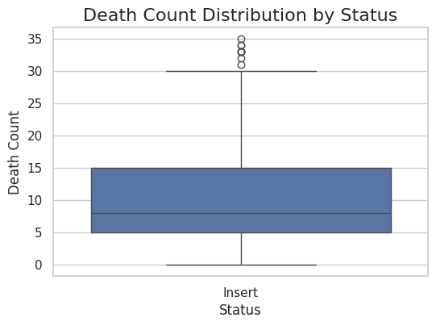
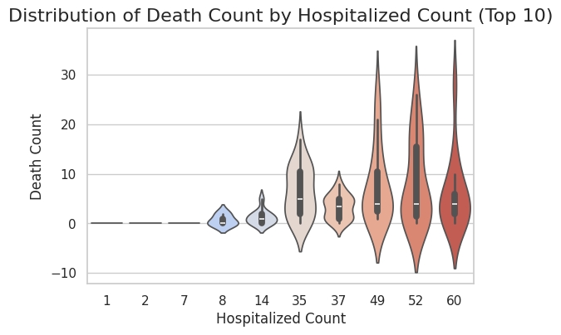
Plotting the Differences:
Scalable Databases FALL 2024 72913

Slide 19
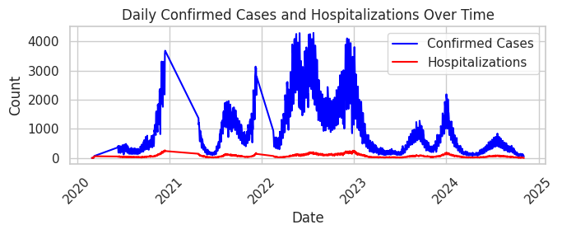
Daily Cases count:
Scalable Databases FALL 2024 72913

Slide 20
Conclusion:
This analysis illuminates the profound impact of the COVID-19 pandemic by weaving together critical data on testing, hospitalizations, and mortality. We explored the powerful correlations between testing positivity and the strain on our healthcare systems. These insights not only reveal the essential patterns of the pandemic's journey but also empower us to assess healthcare burdens and appreciate the effects of our interventions. This work deepens our understanding of COVID-19 and establishes a strong, data-driven foundation for future public health research, guiding informed decision-making and strengthening our readiness for challenges ahead.his analysis illuminates the profound impact of the COVID-19 pandemic by weaving together critical data on testing, hospitalizations, and mortality. We explored the powerful correlations between testing positivity and the strain on our healthcare systems. These insights not only reveal the essential patterns of the pandemic's journey but also empower us to assess healthcare burdens and appreciate the effects of our interventions. This work deepens our understanding of COVID-19 and establishes a strong, data-driven foundation for future public health research, guiding informed decision-making and strengthening our readiness for challenges ahead.

